Slide 1
WELCOME
We are so glad you’re here.

Slide 2
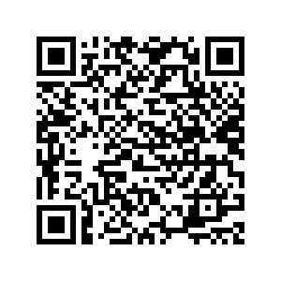
Building Your School Mental Health Team
Erika Franta, PhD Hannah West, PhD, BCBA
Notes:
Welcome everyone! We are so glad that you are here today to work together to learn best practices around Teaming to address School Mental Health – and spend time together learning, applying our practices, and engaging in planning with our team members.

Slide 3
Disclaimer
This presentation was prepared for the MHTTC Network under a cooperative agreement from the Substance Abuse and Mental Health Services Administration (SAMHSA). All material appearing in this presentation, except that taken directly from copyrighted sources, is in the public domain and may be reproduced or copied without permission from SAMHSA or the authors. Citation of the source is appreciated. Do not reproduce or distribute this presentation for a fee without specific, written authorization from the MHTTC Network Coordinating Office. This presentation will be recorded and posted on our website.
At the time of this publication, Miriam Delphin-Rittmon served as Assistant Secretary for Mental Health and Substance Use and Administrator of SAMHSA. The opinions expressed herein are the views of the speakers and do not reflect the official position of the Department of Health and Human Services (DHHS), or SAMHSA. No official support or endorsement of DHHS, SAMHSA, for the opinions described in this presentation is intended or should be inferred.
This work is supported by grants under Funding Opportunity Announcement (FOA) No. SM-18-015 from the DHHS, SAMHSA.
Since we are federally funded, we will have you complete a brief survey at the end of the session. This is different from the conference feedback survey. Please complete both, as we value your feedback.

Slide 5
The MHTTC Network accelerates the adoption and implementation of mental health related evidence-based practices across the nation
Develops and disseminates resources
Provides free local and regional training and technical assistance
Heightens the awareness, knowledge, and skills of the mental health workforce

Slide 6
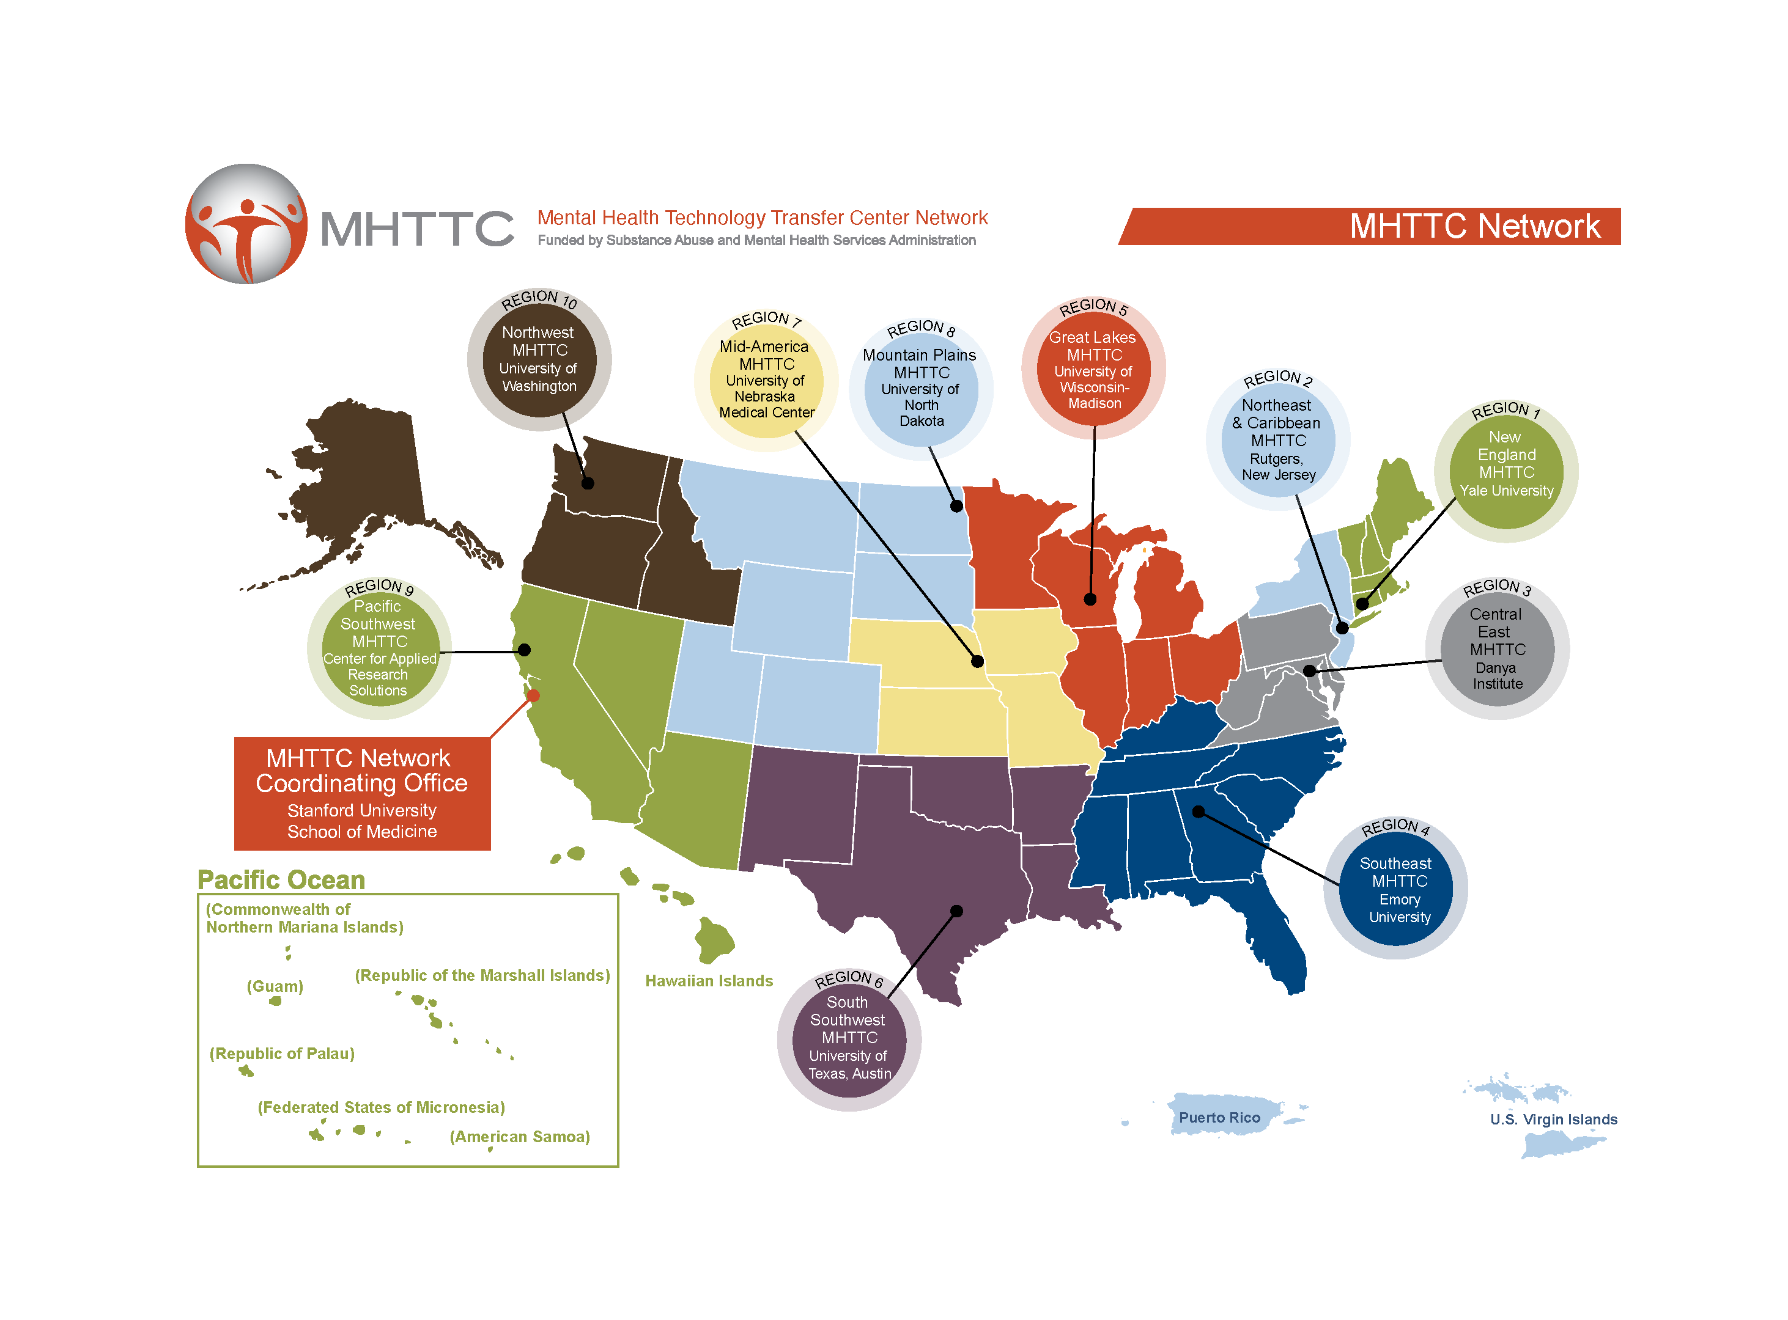
Mental Health Technology Transfer Center
Mental Health Technology Transfer Center (MHTTC) Network
Established in 2018 with funding from the Substance Abuse and Mental Health Services Administration (SAMHSA)
10 Regional Centers
Network Coordinating Office
Visit the MHTTC website at https://mhttcnetwork.org/
National School Mental Health Implementation Guidance Modules
Notes:
The MHTTC Network is funded by SAMHSA. The MHTTC Network includes 10 Regional Centers, a National American Indian & Alaskan Native Center, a National Hispanic & Latino Center, and a Network Coordinating Office. The Network Coordinating Office, housed at Stanford University School of Medicine, serves as the focal point and provides leadership, infrastructure, and support to the MHTTC Network.

Slide 7
Who We Are
Mid-America MHTTC SMH Team Munroe Meyer Institute University of Nebraska Medical Center
Presenters
Erika Franta, PhD, LP
Hannah West, PhD, LP, BCBA

Slide 8
Who do we have here?
School Nurses
School Mental Health Professionals
Educators
Anyone else?
Notes:
Britt

Slide 9
Foundations of Comprehensive School Mental Health
Notes:
To set the tone for today, we want to be sure to cover the why behind we are here today – working together to effectively implement comprehensive school mental health systems that support the youth, families, and staff that we serve in each of our communities.

Slide 10
Most commonly diagnosed mental disorders in children
ADHD 9.8% (approximately 6.0 million)
Anxiety 9.4% (approximately 5.8 million)
Behavior problems 8.9% (approximately 5.5 million)
Depression 4.4% (approximately 2.7 million)
CDC, 2022

Slide 11
Mental Health America: Missouri Youth Data 2023 (rank = 36)
Measure | Rank | Percentage MO/Nation | Number
Youth with at least one Major Depressive Episode (MDE) in past year | 24 | 16.8/16.4 | 79,000
Youth with Severe Major Depressive Episode | 35 | 13.8/11.5 | 64,000
Youth with Substance Use Disorder in past year | 33 | 6.8/6.3 | 32,000
Youth with MDE who did not receive MH services | 43 | 65.3/59.8 | 49,000
Youth with Severe MDE who received some consistent tx | 37 | 21.2/28 | 13,000
Children with private insurance that did not cover MH | 43 | 65.3/59.8 | 49,000
Students Identified with Emotional Disturbance for an IEP | 20 | 8.25/7.18 | 7,056
https://mhanational.org/issues/2023/mental-health-america-youth-data
Notes:
Given the variability of data, MHA developed guidelines to identify mental health measures that are most appropriate for inclusion in our ranking. Indicators were chosen that met the following guidelines:
Data that are publicly available and as current as possible to provide up-to-date results.
Data that are available for all 50 states and the District of Columbia.
Data for both adults and youth.
Data that captured information regardless of varying utilization of the private and public mental health system.
Data that could be collected over time to allow for analysis of future changes and trends.
Factors to consider include geography and size. For example, California and New York are similar. Both are large states with densely populated cities. They are less comparable to less populous states like South Dakota North Dakota, Alabama, or Wyoming. Keep in mind that size of states and populations matter, both New York City and Los Angeles alone have more residents than North Dakota, South Dakota, Alabama, and Wyoming combined.
The rankings are based on the percentages, or rates, for each state collected from the most recently available data. For most indicators, the data represent data collected up to 2018. States with positive outcomes are ranked higher (closer to 1) than states with poorer outcomes. The overall, adult, youth, prevalence and access rankings were analyzed by calculating a standardized score (Z score) for each measure and ranking the sum of the standardized scores. For most measures, lower percentages equated to more positive outcomes (e.g. lower rates of substance use or those who are uninsured). There are two measures where high percentages equate to better outcomes. These include Youth with Severe MDE (Major Depressive Episode) who Received Some Consistent Treatment, and Students Identified with Emotional Disturbance for an Individualized Education Program. Here, the calculated standardized score was multiplied by -1 to obtain a Reverse Z Score that was used in the sum. All measures were considered equally important, and no weights were given to any measure in the rankings.
Along with calculated rankings, each measure is ranked individually with an accompanying chart and table. The table provides the percentage and estimated population for each ranking. The estimated population number is weighted and calculated by the agency conducting the applicable federal survey. The ranking is based on the percentage or rate. Data are presented with 2 decimal places when available.
(1) the data in this report likely under-reports the current prevalence of mental illnesses in the population, both among children and adults, (2) higher-ranked states may have been better prepared to deal with the mental health effects of the pandemic at its start, and (3) because of its nationwide effect, nothing in the pandemic by itself would suggest that the relative rankings of the states would have changed solely because of the pandemic

Slide 12
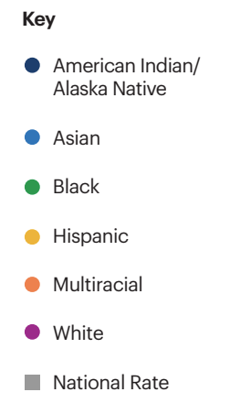
Link to Brief
Notes:
Now let's break some of this down by different demographic variables. As this graph is showing, there is a wide range of mental health concerns and experiences across race and ethnicity. Although this is not specific to Nebraska, we might expect that it maps on to what youth in Nebraska might be experiencing as it is a national sample. We see that minoritized youth often show greater mental health concerns, which are likely linked to the variety of experiences of systemic racism and oppression.

Slide 13
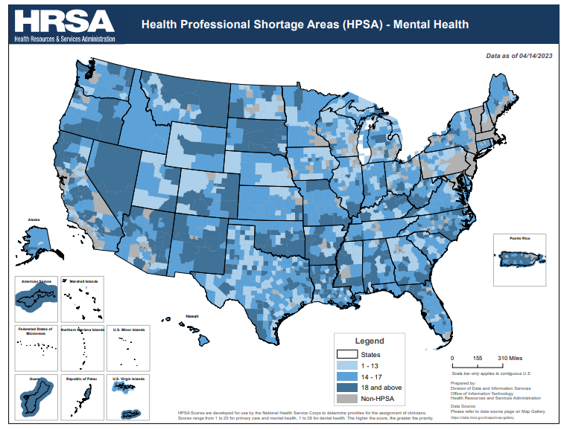
HRSA, 2023
Notes:
Shortage priorities determined by ratio of population to providers and access (excessively distant, over-utilized, or inaccessible) to population. In Nebraska, you’ll notice that the only areas of our state that are not in HPSA-mental health areas are those in the Omaha Metro Area. Thus, further supporting the need to increase access to mental health resources through community and school settings.

Slide 14
School Mental Health Impact
School Mental Health Impact
NCSMH, 2019
Notes:
There is growing data to support the accessibility and impact of school mental health.
As noted, students who participate in social emotional learning programs do better academically and socially than those who don’t.
Also, a positive school climate and social emotional learning improves school safety and decreases bullying.
In addition to schools being the place where most students receive mental health services, youth are six times more likely to complete mental health treatment in schools than in other community settings.

Slide 15
Comprehensive School Mental Health

Slide 16
Comprehensive School Mental Health Systems
provide a full array of supports and services that promote positive
school climate, social emotional learning, mental health and well-being, while reducing the prevalence and severity of mental illness
built on a strong foundation of district and school professionals,
including administrators and educators, specialized instructional support
personnel (e.g., school psychologists, school social workers, school counselors, school nurses and other school health professionals)
in strategic partnership with students, families and community health and mental health partners
assess and address the social and environmental factors that impact health and mental health

Slide 17
Core Features
Core Features
Educators and Student Instructional Support Personnel
Adequate staffing and support
Trained to address student mental health in schools
Collaboration and Teaming
Youth and families
Community health/mental health and other partners
Multitiered System of Supports
Mental health promotion support (Tier 1)
Early intervention and treatment services and supports (Tiers 2-3)
Evidence-Informed Services and Supports
Cultural Responsiveness and Equity
Data-Driven Decision-Making
Notes:
There are several core features of comprehensive school mental health systems. Each of these will be examined in more depth here and throughout the training.
Core Features include:
Educators and Student Instructional Support Personnel
Collaboration and Teaming
Multitiered System of Supports
Evidence-Informed Services and Supports
Cultural Responsiveness and Equity
Data-Driven Decision-Making
Several successful state and local examples of these core features provide a road map to achieve wide scale adoption of comprehensive school mental health systems across the United States, and will be used as examples throughout this training resource.

Slide 18
It’s crucial that when addressing the mental health behavioral health of students, families, educators, and schools, we do so not in a vacuum, but in the larger socio-political context.

Slide 19
Multi-Tiered System of Supports
Tier 3
Professional development and support for a healthy school workforce
Family-School-Community partnerships
Tier 2
Supports & early intervention for students identified as at-risk for mental health concerns
Tier 1
Promotion of positive social, emotional, and behavioral skills and overall wellness for all students
Intensive interventions
for students with
serious concerns impacting functioning
IMPORTANT REMINDERS:
Children who are...
receiving Tier 2 interventions are also receiving Tier 1 supports
receiving Tier 3 interventions are also receiving Tier 1 and 2 supports and interventions
Notes:
When we are considering evidence-based practices, not only are we ensuring that the actual practices that we are implementing are evidence-based but also that we are using data to ensure that those who are receiving services need those services. This means that we need to be cognizant of two things: (one) that our practices are backed by research and (two) that we use data to monitor who is responding to the research backed practices. While you all may not be directly involved in this process, it is critical to understand how these processes should ideally work to help you determine work flow for your practice or the clinicians you oversee.
We all have probably seen this triangle more than we have ever wanted. This triangle is super important as it helps us promote evidence-based practices. At the foundation, we have established partnerships and professional development of educators for a healthy school environment. At Tier 1, every single student is receiving intervention. This includes SEL, PBIS, and MH screening. At Tier 2, students receive targeted interventions to support their mental and behavioral wellbeing in the school environment; typically, we see small groups at Tier 2. At Tier 3, students receive intensive interventions to support their wellbeing in the school environment; typically, we see individual sessions with the student at Tier 3.
What is often forgotten about within this model is that children who are receiving Tier 2 and 3 interventions should be receiving all of the supports in the tiers below. Meaning, children who are receiving Tier 2 inventions are also receiving Tier 1 supports. Children who are receiving Tier 3 interventions are also receiving Tier 1 and 2 supports and interventions. To make decisions on what students receive Tier 2 and 3 supports appropriately, we need to use data.

Slide 20
Teaming: Best Practices

Slide 21
Co-developed by the Mental Health Technology Transfer Center (MHTTC) Network and the National Center for School Mental Health (NCSMH) with financial support from SAMHSA.
This work is supported by grant SM081726 from the Department of Health and Human Services, Substance Abuse and Mental Health Services Administration.
Notes:
The basis of the content that we are covering today comes from the National SMH Best Practices: Implementation Guidance. This was co-developed by the…. We also hosted an institute with ESU teams back in 2021, with your teams hosting your own ESU level institutes annually since then!

Slide 22
What is a school mental health team?
A team of school and community stakeholders at a school or district level that meets regularly, uses data-based decision-making, and relies on action planning to support student mental health.
What Is a School Mental Health Team?
National School Mental Health Implementation Guidance Modules
Notes:
A school mental health team is defined as a team of school and community stakeholders at a school or district level that meets regularly, uses data-based decision-making, and relies on action planning to support student mental health.
Key words to keep in mind are regularly, data-based decision-making, and action planning.

Slide 24
Value of School Mental Health Teams
Value of School Mental Health Teams
Communication
Collaboration
Mutual support
Common vision and priorities
Resource maximization
National School Mental Health Implementation Guidance Modules
Notes:
Schools and districts have so many teams you might be wondering why you would need one focused specifically on school mental health at the district and school levels.
First, school mental health teams serve to coordinate communication, collaboration, and mutual support among individual team members who might otherwise operate in isolation.
School mental health teams also develop a common vision and priorities for improvement to ensure that the school mental health system is meeting the needs of all students and the larger school community.
Finally, school mental health teams can explore how to maximize limited resources to address the mental health needs of students and their families in a systematic, strategic manner.

Slide 25
Establishing Partnership Agreements
Contracts
Memoranda of Understanding
Data Sharing Agreements
Referral Systems
Methods for teaming, collaboration, and information sharing
Notes:
Describe parties of contract or agreement
Describe services included as part of the agreement
Describe timeline/terms of agreement
Agreed compensation
Terms of independent contractor (if applicable)
Liability
Insurance
Confidentiality
Termination
Professional services delivered

Slide 26
Resources
HIPAA/FERPA
Neither HIPAA nor FERPA should be seen as insurmountable obstacles for school-community partnerships.
Be clear about what information can and cannot be shared with whom.
Strike a balance.
Have guardians sign a release of information form that clearly defines what will be shared.
Create a policy for how your district will share information with your community partner(s).
Notes:
To help states, districts, and schools across the United States understand the core components of comprehensive school mental health, as well as engage in a planning process, the Mental Health Technology Transfer Center (MHTTC) Network Coordinating Office and National Center for School Mental Health (NCSMH) developed a national school mental health curriculum focused on the core features of effective school mental health initiatives listed above.

Slide 28
Heuristics to Live By
Every parent is a good parent
Every parent is doing the best they can
Every child has the right to be successful
We change behavior by teaching, practicing, and reinforcing
Every teacher is a good teacher
Every teacher is doing the best they can
Every child is a good child
Every child is doing the best they can

Slide 29
Integrating health into the school team…
Tier 3
IEP/MDT Meetings, Teacher Consultation
Tier 2
Student Problem Solving Team Meetings
Tier 1
Leadership Meetings, Staff Meetings, Classroom Consultation
Approaching with curiosity
Offering support to school team members
Assisting in alignment of teaming practices
Describing and providing support and intervention for the behaviors and symptoms of concern (vs diagnosing)
Speak to our skills
"Giving skills away"
Consulting
Asking questions about mental health
Discussing how mental health impacts school functioning
Including mental well-being as a domain that we discuss

Slide 30
Matching Resources to Student Needs
Link to Resource
Osage County Interlocal Cooperative, 2017
Notes:
Choosing what components are going to be a part of your plan can be challenging, but luckily, you can select intervention components as a part of a team. On this slide, you will find a resource that takes your team through intervention components that might be helpful.

Slide 31
Quality Indicator
Goal Setting
To what extent did your district/school ensure intervention goals are specific, measurable, achievable, relevant, time bound, inclusive, & equity minded (SMARTIE)?
Work with the student, parents, and teacher(s) to establish goals.
Ensure goals are specific.
Establish a measurement plan and set an achievable benchmark.
Ensure goals are time specific.
Ask yourself how you’re incorporating equitable and inclusive practices and mindsets into your goals.
National School Mental Health Implementation Guidance Modules
Notes:
Consider: To what extent did your district/school ensure intervention goals are specific, measurable, achievable, relevant, and time bound (SMART)?
One basic yet critical way to ensure early intervention and treatment services and supports are of consistent quality and students begin with the best chance of success is to create interventions goals that are SMART. SMART goals are:
Specific
Measurable
Achievable
Relevant
Time bound
Goals may be documented in a treatment plan, individualized education program (IEP), or other charting or documentation system to track student response to intervention over time.
Best practices for this indicator include:
Work with the student, family, and school staff to establish specific goals for the student’s success. This typically involves standardized data collection, observation and/or discussion
Ensure goals are specific (concrete, detailed, and well-defined) and aligned with student and family’s cultural values, beliefs, strengths, and needs
Include strengths-based and person-first language (where appropriate)
Establish a measurement plan and set an achievable benchmark What is achievable will depend on the baseline. For example, if the student is not currently staying in school any days of the week, an achievable goal might be to stay in school 2 out of 5 days to start. Or, if the student is currently referred to the front office once per day, an achievable initial goal might be to decrease office referrals from 5 per week to 3 per week
Ensure goals are time specific, meaning there is a target date identified and interim steps are included to monitor progress during a specific timeline for goals to be achieved

Slide 32
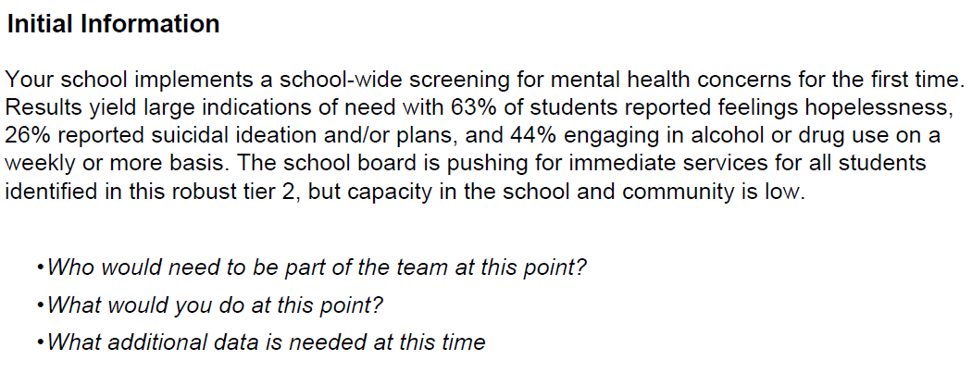
Let’s practice!

Slide 33
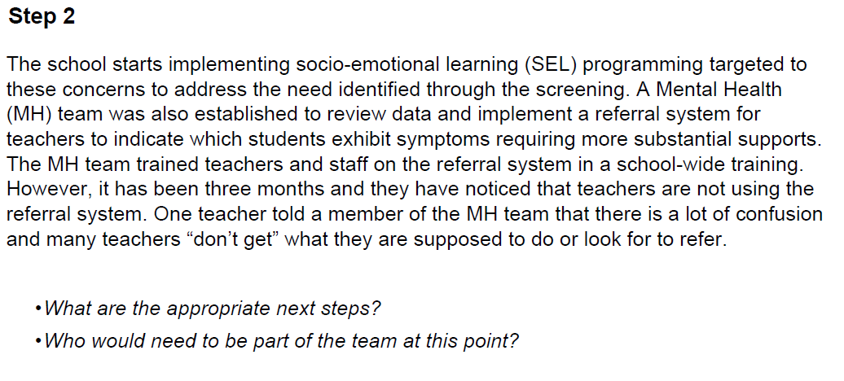

Slide 36
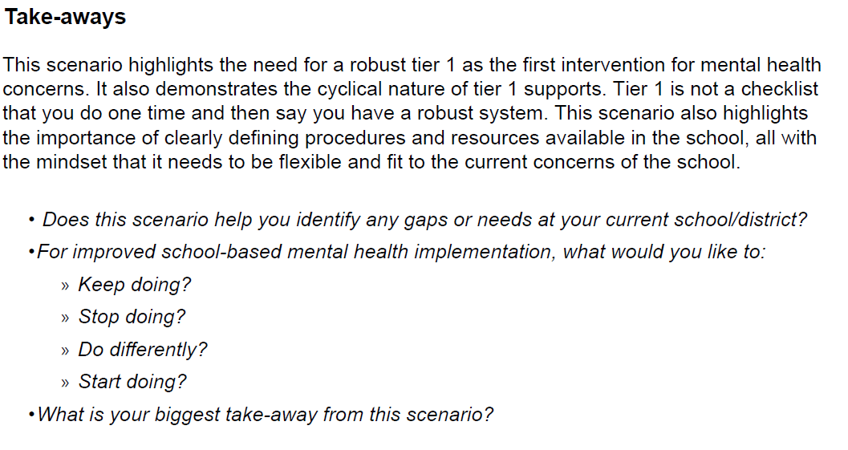

Slide 37
Questions?

Slide 38
Quality Guides
Teaming QG
Needs Assessment and Resource Mapping QG

Slide 39
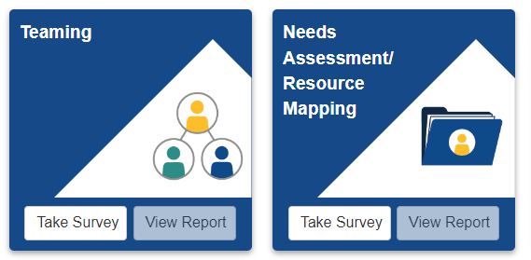
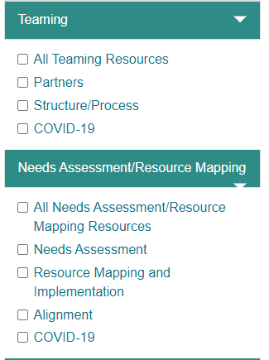
Resource Highlight from SHAPE
SHAPE Resource Library

Slide 40
Additional School Mental Health Resources & Opportunities

Slide 42
Adult Resilience Curriculum Mid-America MHTTC Professional Well-Being Website
Activity Handouts
Trainer Manual
Resource Lists
Video Modules & Slide Decks
30 Day Mental Health Challenge
Burnout Busters Podcast
Notes:
And the last component of Tier 1 that we want to discuss is supporting educators. Being an educator has always been a demanding job. However, in the last few years with virtual learning, difficult school board meetings, increased student behaviors, and discontent with the educational system, it has been especially difficult. With partners from universities, we have worked to disseminate the Adult Resilience Curriculum for Educators, which combines several therapeutic theories and approaches into modules and workbooks that all aim to support educators in taking care of themselves. As a part of this curriculum, we have developed modules, manuals, workbooks, and a podcast that can be used and be embedded into your Tier 1 approaches to support the adults who support students.
Any questions about Tier 1 strategies before we jump into Tier 2?

Slide 44
Request Technical Assistance

Slide 45
Take Our Survey
Follow the link
https://ttc-gpra.org/P?s=122543
OR
Use your smartphone’s Camera app to scan the QR code

Slide 46
Acknowledgments
Acknowledgments
This work is supported by grant SM081726 from the Department of Health and Human Services, Substance Abuse and Mental Health Services Administration. Module content was developed by the National Center for School Mental Health in partnership with the MHTTC Network Coordinating Office.
National School Mental Health Implementation Guidance Modules

